Slide 1
WEB SCRAPING
Livingstone Ndigezza

Slide 2
Data scraping
Types of data scraping
Web scraping
Process of web scraping

Slide 3
Data scraping
Data scraping - is a technique in which a computer program extracts data from human-readable output coming from another program.

Slide 4
Types of data scraping
Screen scraping is the method of collecting screen display data from one application and translating it so that another application is able to display it.
Report mining is the extraction of data from human readable computer reports.
Web scraping is a web technique of extracting data from the web, and turning unstructured data on the web (including HTML formats) into structured data that you can store to your local computer or a database.

Slide 5
Types of data scraping
Screen scraping is the method of collecting screen display data from one application and translating it so that another application is able to display it.
Report mining is the extraction of data from human readable computer reports.
Web scraping is a web technique of extracting data from the web, and turning unstructured data on the web (including HTML formats) into structured data that you can store to your local computer or a database.

Slide 6

Manual scraping: Copy-paste technique

Slide 7
Text Pattern Matching
This is a regular expression-matching technique using the UNIX grep command, and clubbed with popular programming languages
message = 'Call me at 0703832978 tomorrow. 0782165397 is my office.' for i in range(len(message)): chunk = message[i:i+12] if isPhoneNumber(chunk): print('Phone number found: ' + chunk)

Slide 8

Computer vision web-page analysis
There are efforts using machine learning and computer vision that attempt to identify and extract information from web pages by interpreting pages visually as a human being might.

Slide 9
Vertical Aggregation
Vertical aggregation platforms are created by companies with huge computing power, targeting a specific verticals. Some even run these data harvesting platforms on the cloud. Creation and monitoring of bots for specific verticals is done by these platforms, with virtually no human intervention. Since the bots are created automatically based on the knowledge base for the specific vertical, the efficiency of the bots is measured by the quality of data extracted.

Slide 10
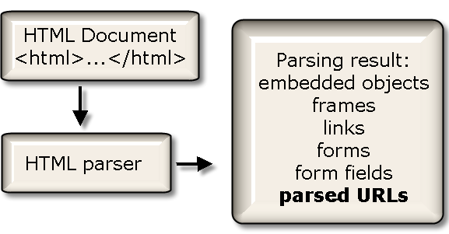
HTML Parsing
HTML parsing is done using Java scripts, and targets linear or nested HTML pages. This fast and robust method is used for text extraction, link extraction (for example, nested links or email addresses), resource extraction, and so on.

Slide 11
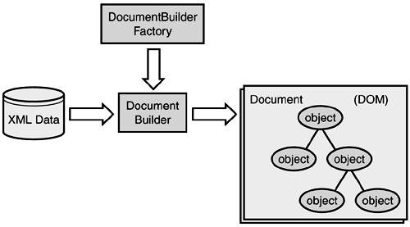
DOM Parsing
Document Object Model, or DOM, defines the style, structure and the contents contained within the XML files. DOM parsers are generally used by scrapers that want to get an in-depth view of the structure of the web page. One can use the DOM parser to get the nodes containing information, and then use a tool like XPath to scrape web pages.

Slide 12
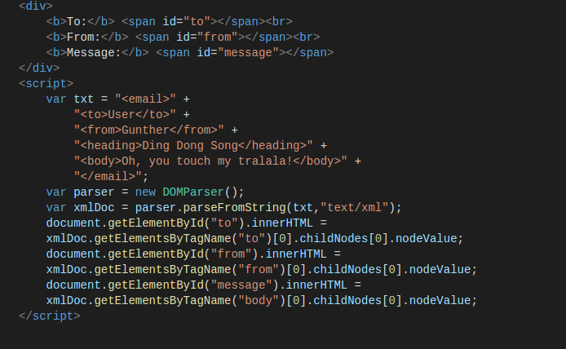
Simple DOM Parser

Slide 13
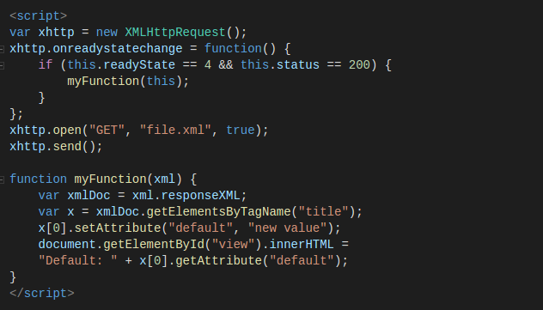
Simple DOM Parser

Slide 14
Tools for web scraping
Selenium
Import.io
Phantom.js
Scrapy
etc.

Slide 15
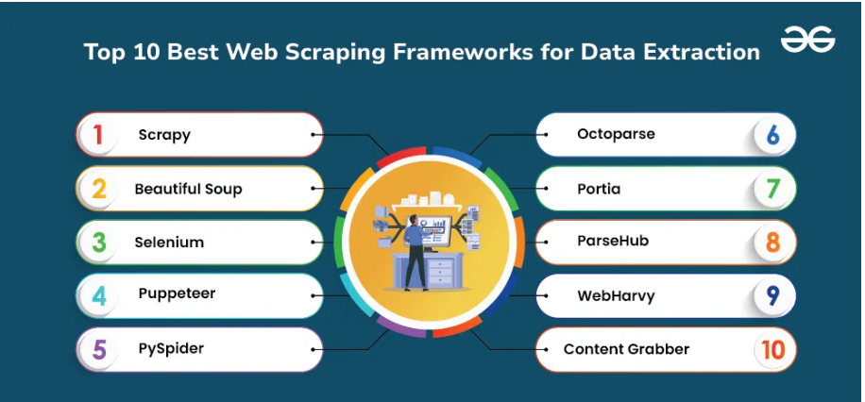
Web Scraping Frameworks

Slide 16
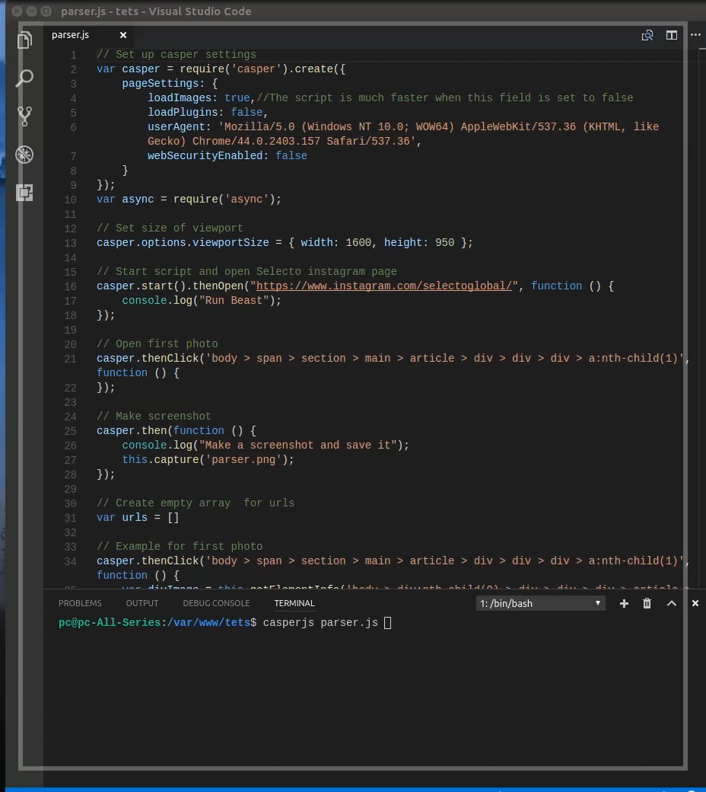

Slide 17
Commercial Platforms
Bright Data (formerly Luminati): A premium proxy-based platform with strong scraping features.
Import.io: Allows scraping without coding which is ideal for non-programmers.
Webhose.io: Offers structured data feeds for news, blogs and online content.
Dexi.io and Scrapinghub: Provide cloud-based scraping services with built-in scheduling, storage and proxy support.
Each tool has its strengths and its choice depends on the complexity of the website, the volume of data and our technical background.

Slide 18
Legal and Ethical Considerations
While web scraping is an useful tool but it must be done responsibly and within legal boundaries. Here are some important points to keep in mind:
Respect robots.txt and Terms of Service: These define the allowed scope of bot access.
Avoid Server Overload: Limit request frequency to prevent disrupting website functionality.
Only Access Public Data: Avoid scraping personal or copyrighted content without permission.
Comply with Copyright Laws: Redistributing scraped content may violate intellectual property rights.
Avoid Malicious Use: Never use scraping for spam, data theft or denial-of-service attacks.
Practicing ethical scraping ensures compliance and maintains a positive relationship with website owners.

Slide 19
Challenges to Web Scrapping
Although web scraping is useful, it comes with several challenges that can make the process difficult:
Website Structure Changes: Websites sometimes update their design and code which can break scraping scripts that rely on specific HTML elements. Scrapers need regular maintenance to keep up with these changes.
Anti-Scraping Technologies: Many websites use measures like IP blocking, CAPTCHA or dynamic content loading to prevent automated scraping.

Slide 20
Challenges to Web Scrapping
Data Storage and Management: Large-scale scraping generates huge volumes of data. Efficiently storing organizing and processing this data requires good infrastructure and planning.
Ensuring Data Quality: Extracted data might be incomplete, duplicated or outdated. Cleaning and validating data to maintain accuracy is an important but challenging step.
Legal Risks: As discussed earlier, scraping without permission or violating terms of service can lead to legal consequences or blocked access.
Performance and Speed: Balancing fast data extraction while avoiding detection or server overload requires careful handling of request rates and scraping strategies.
Understanding these challenges helps in planning and building effective scraping solutions.

Slide 21
Future of Web Scrapping
Web scraping is growing rapidly as the amount of online data grows exponentially. Its future is shaped by advances in technology, legal frameworks and business needs:
Integration with Big Data and AI: Combining web scraping with big data analytics and artificial intelligence will helps in deeper insights and smarter decision-making. Automated data collection will feed more accurate, real-time information into AI models.
Improved Tools and Automation: Newer tools will offer easier, faster and more reliable scraping solutions including better handling of dynamic content and anti-scraping measures.

Slide 22
Future of Web Scrapping
Greater Focus on Ethics and Compliance: As legal frameworks develop, scraping will become more regulated helps in encouraging responsible and transparent data collection practices.
More APIs and Structured Data: Websites may provide more APIs or structured data feeds which helps in reducing the need for scraping and making data access easier and safer.
N.B Mastering web scraping tools and techniques is important for anyone looking to see the full potential of online data in today’s digital world.

